Slide 1
Xcelerate Technology Partner Program Webinar August 17, 2016

Slide 2


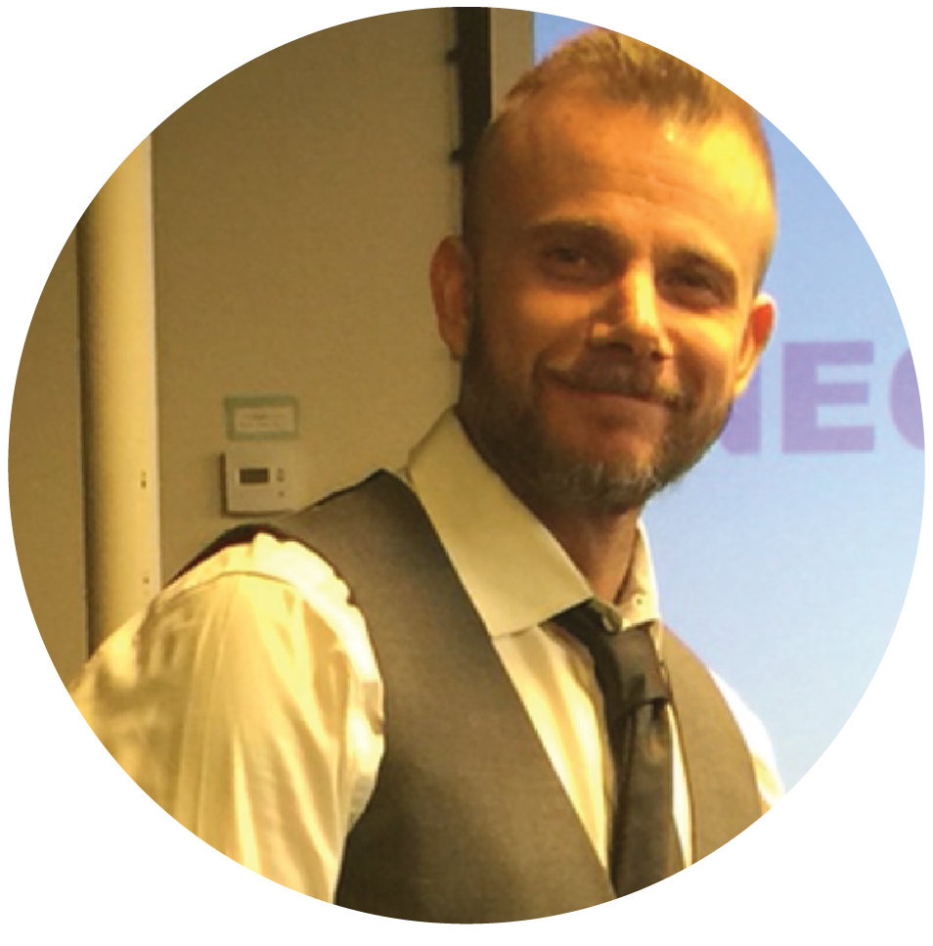

What We’ll Cover Today
Mark Lenhard
Growth & Strategy
Bhavin Rawal
Marketplace
Jon Carmody
Tech Partner Management
Joy Daniels
Tech Partner Marketing
Xcelerate Program
Demand Generation
Recent Activities
Q & A

Slide 3







Premier Technology Partner Shout Out

Slide 4



































Select Technology Partner Shout Out

Slide 5

Technology Partner Program
New Name
New Commitments
New Benefits
Notes:
Building upon our foundation
Let’s be clear that the objective here is to communicate an evolving partner program that drives mutual success.
Deeper strategic partnerships, trackable benefits and leads, verified extensions, better ways to inspire
Better Quality Extensions

Slide 6



Depths of Engagement
Merchant Admin Panel Listing
Dedicated Magento.com Landing Page
Premier Partner Badge
Deeper Co-Marketing Opportunities
Premier
(Formerly Platinum)
Levels 1 & 2 Quality Checks
Select Partner Badge
Joint Marketing Activities
Internal Magento Activities
Priority Sponsor Bookings
Select
(Formerly Gold & Silver)
Registered
(Marketplace Only)
Marketplace Listing
Level 1 Quality Check
Marketplace Promotion
Notes:
New levels

Slide 7
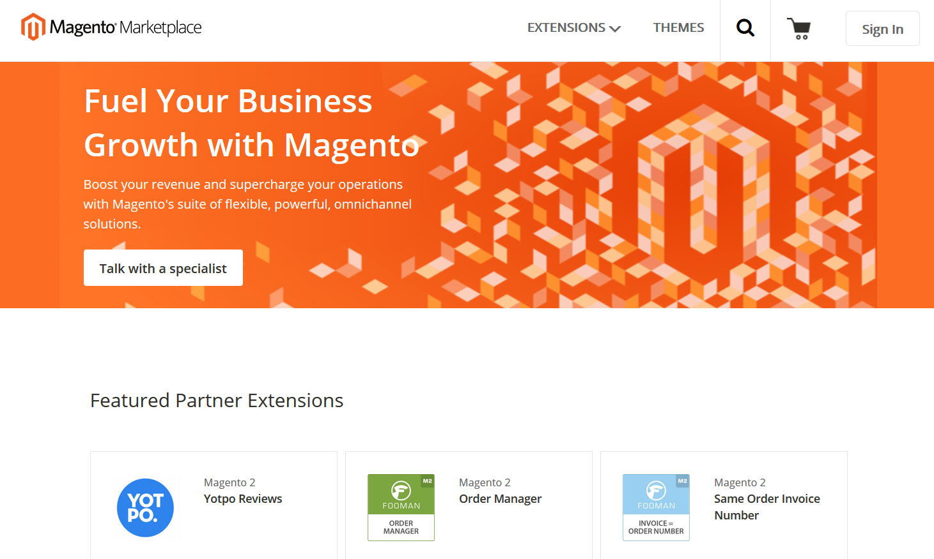
Marketplace

Slide 8
The Extension Quality Program
Level 1 Quality Check
Level 2 Quality Check
Auto Check for All Extensions
Verification for
Premier and Select Partners
Package validation
Essential coding standards
Antivirus and malware
Plagiarism check
Security check
Documentation review
Deep code review
Security check
Q A check
Level 2 Partners receive a Top Quality banner
Notes:
Mention that Marketplace Developers can opt to get the Level 2

Slide 9
Marketplace Update
Updated Coding Standards and Quality Check
Improved Search Experience
New Category Structure
Updated Look and Feel
Magento 1.x extensions on Marketplace
Enhanced code security and vulnerability scans
Coming Soon
Notes:
We are thrilled with the progress we have made and thank you for your continued support as we work to deliver a great Merchant experience.
Since the launch of the Magento Marketplace on April 11, we been making improvements to the inventory selection, quality standards, and user experience. We’ve grown inventory on the store by more than 50%. We know have ___[latest # is 235]__ extensions available for purchased or download. At the same time, we continue to refine the process and tools we use to enforce quality standards for all Marketplace inventory. We recently updated our coding standards quality check and published our methods publically via github so that developers can self-check their code as they are preparing extensions for submission to the Marketplace. We recently integrated Magento Premier partner Celebros as the search engine powering Marketplace – in the coming weeks we will be using Celebros’ technology to further tune Marketplace search based on keyword usage and popular products.
The Marketplace aims to serve and promote the Magento developer community. To this end, we have launched extension developer Success Stories which provide company profile information and detail on the benefits achieved from using the developer’s products. Additionally, we continue to work hard to drive traffic to Marketplace in order to showcase the high quality work of our developers through various marketing activities such as email, social media, webinars, and other demand generation activities.
Our community is such an important resource for Marketplace. Coinciding with the launch of the Marketplace, we created the Marketplace Developer Council, a rotating set of Magento community developers who provide input and feedback on the Marketplace product, inventory and policies. The council provides an opportunity for the Marketplace team to listen directly to the Magento community. Thus far, we’ve completed three developer council meetings and the input we’ve received has resulted in actions taken on inventory and quality management and product roadmap prioritization.
We are updating partner labels to reflect the recent changes to the Magento Partner program announced at Imagine.
Going forward, we will continue to make investments in the Marketplace. We are preparing the Marketplace for submission and purchase of Magento 1.x extensions. This will be accompanied by migration of data from Magento Connect, our legacy product supporting Magento 1.x extensions. Soon we will require inventory to pass new code security and vulnerability scans, improving the overall quality of items listed on the Marketplace. Extensions that pass the highest quality standards applied to Marketplace inventory will receive promotional marketing that highlights their work to potential customers.

Slide 10
Marketplace Momentum
Over 2x number of extensions since launch.
Sales are quickly growing week-over-week.

Slide 11
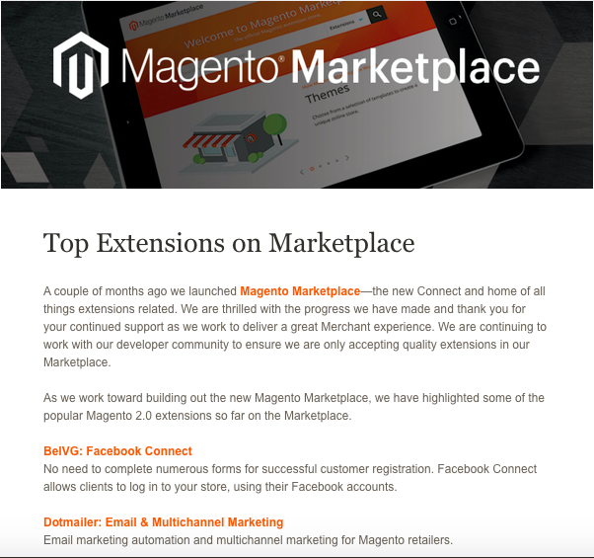
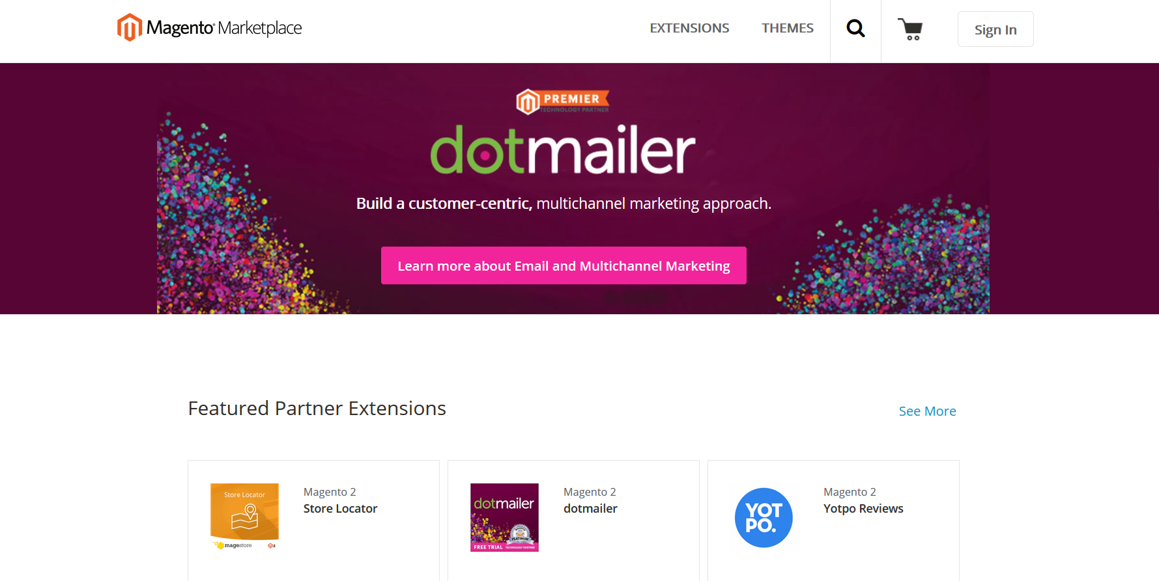
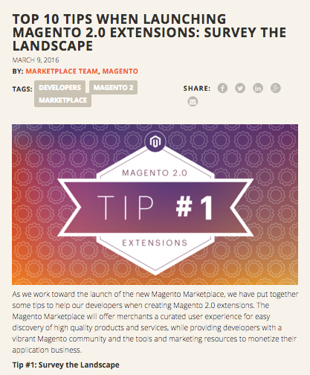
Driving Demand for You
Marketplace Emails
Featured Partners & Promos
Tip Blogs
Notes:
Emails
Blog Posts
Social Posts
Website Feature
Success Stories

Slide 12
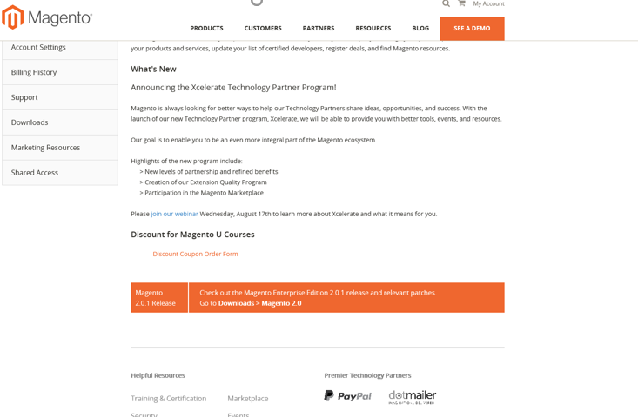
Partner Portal Updates + Referrals
1. Sales / Consulting Teams
2. Marketplace / Directory
3. Marketing / Events
Your hub of Magento information and leads
Notes:
More to come:
Lead Sharing
Roadmap Visibility
Better Communication
New Resources

Slide 13
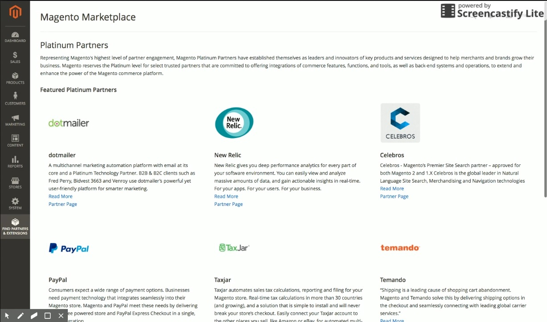
Driving Demand to You
Partner Magento 2 Admin Panel Integration
Notes:
Premier Benefit
Front and Center
In-Product

Slide 14
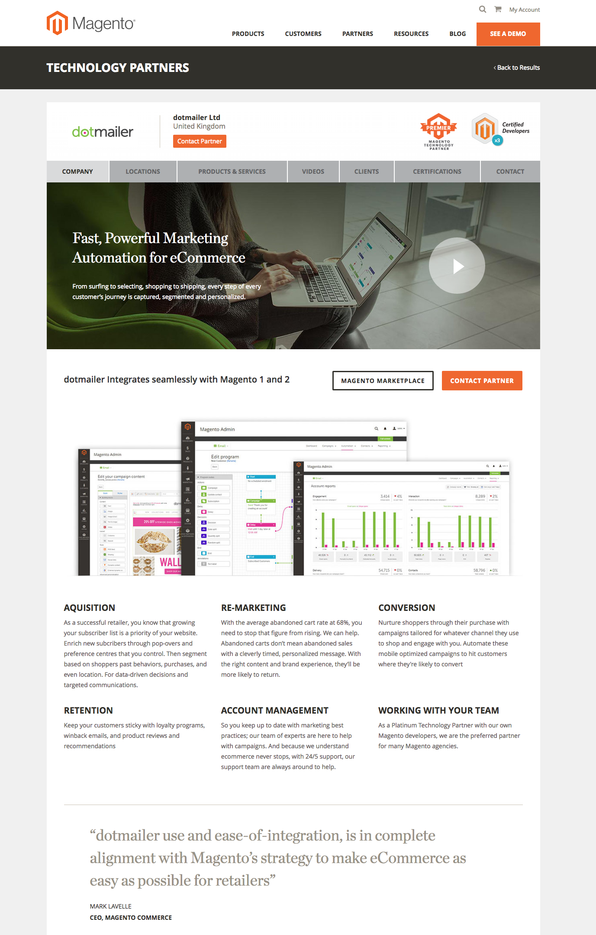
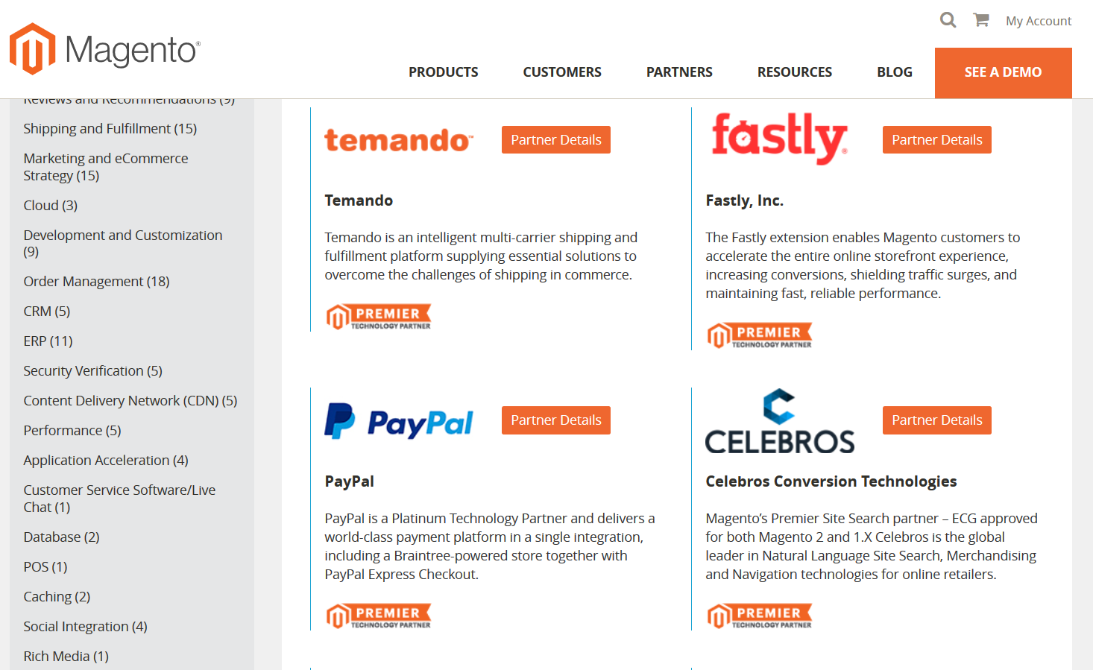
Driving Demand to You
Premier Partner Landers & Partner Directory
Notes:
Roadmap Visibility / Better Communication / New Resources / Lead Sharing

Slide 15


Showcasing Thought Leadership & Capturing Leads
Gated White Papers
Registered Webinars
Content Please!
Notes:
Webinars, White Papers, Customer Stories, Blogs, Video, Infographics, Joint Communications, and Demo Integrations
Some content is gated, some is not for lead generation
Call for Content!

Slide 16

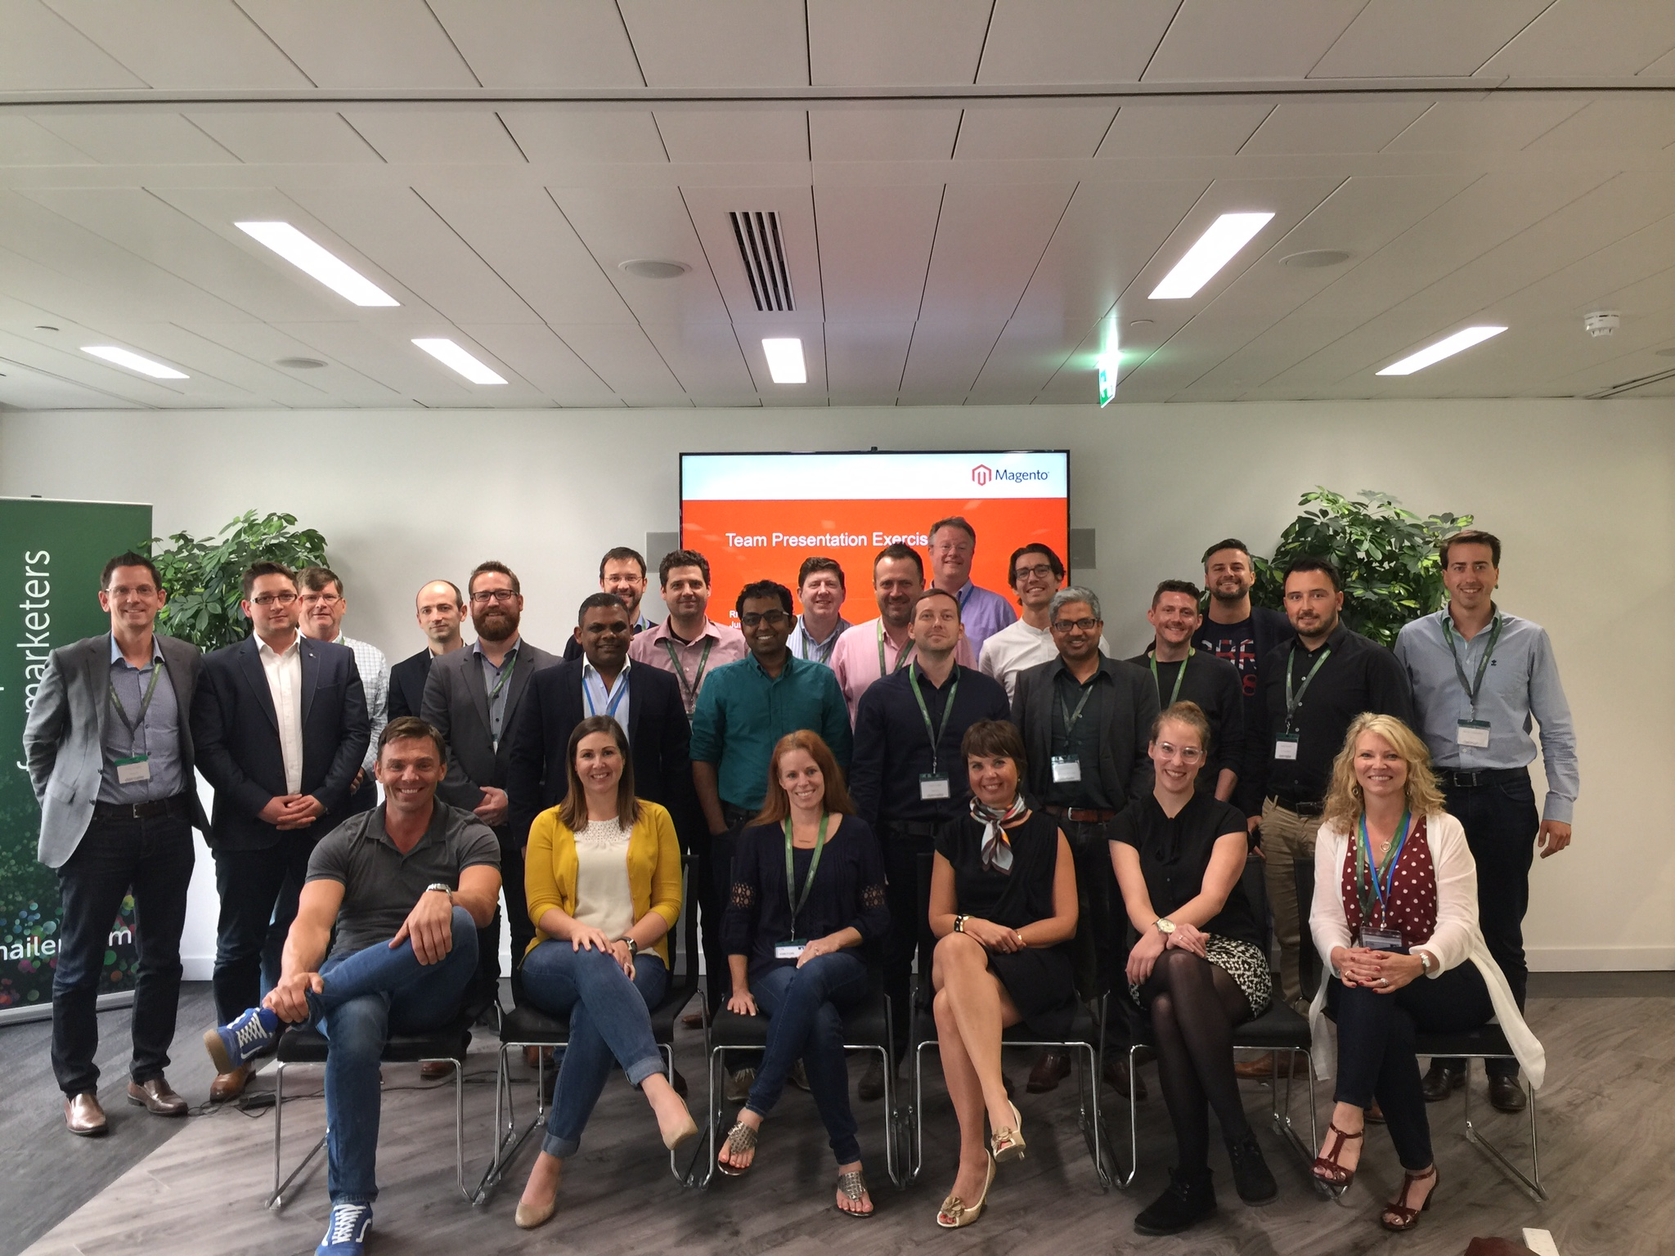
Accessing the Magento Ecosystem
Magento Events, SI Events, Sales Training, and Kick-Offs
Notes:
Better Access to Merchants, Customer Team, Sales Teams, Internal Magento Teams

Slide 17
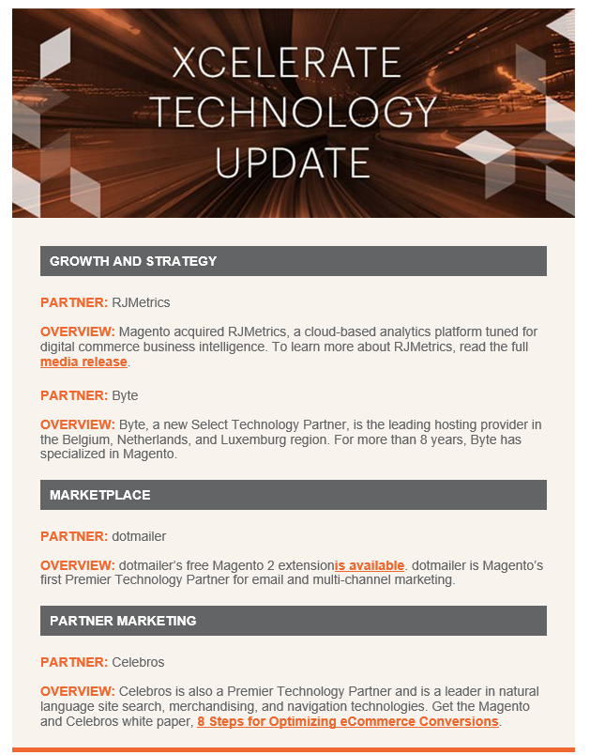
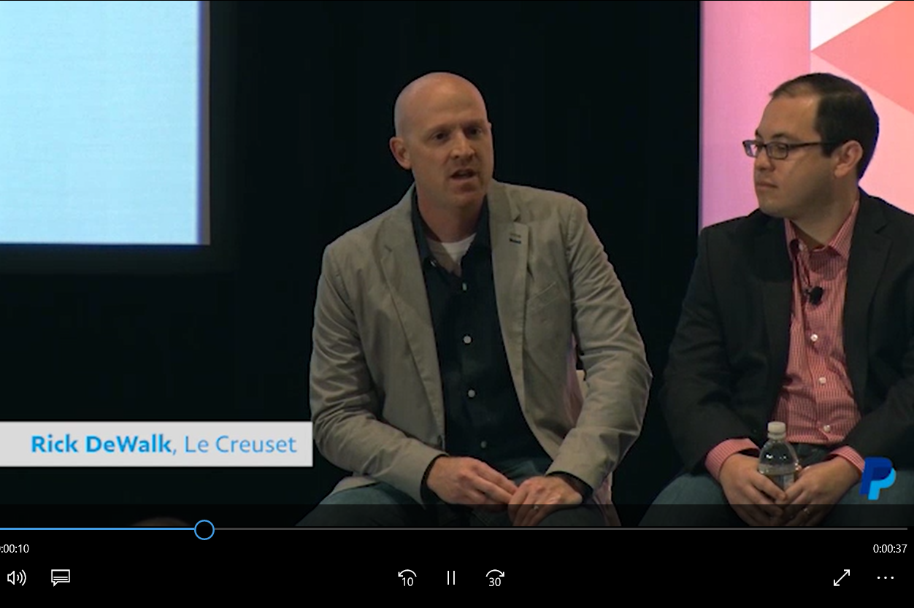
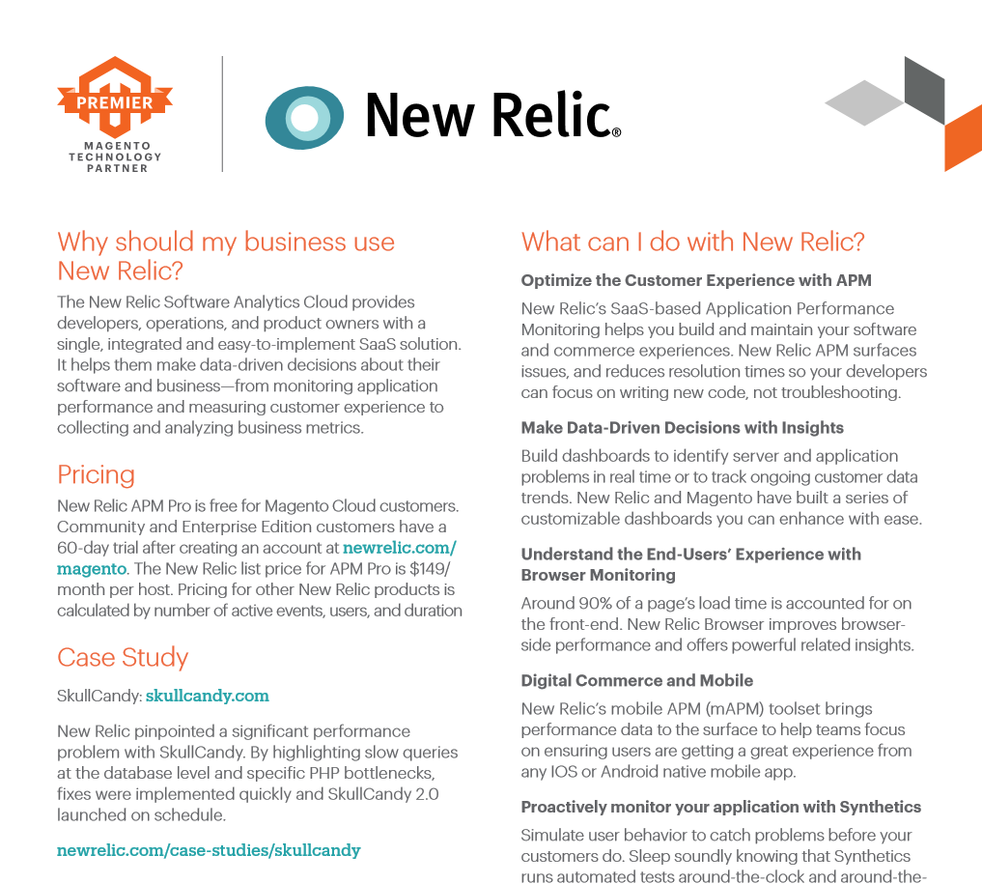
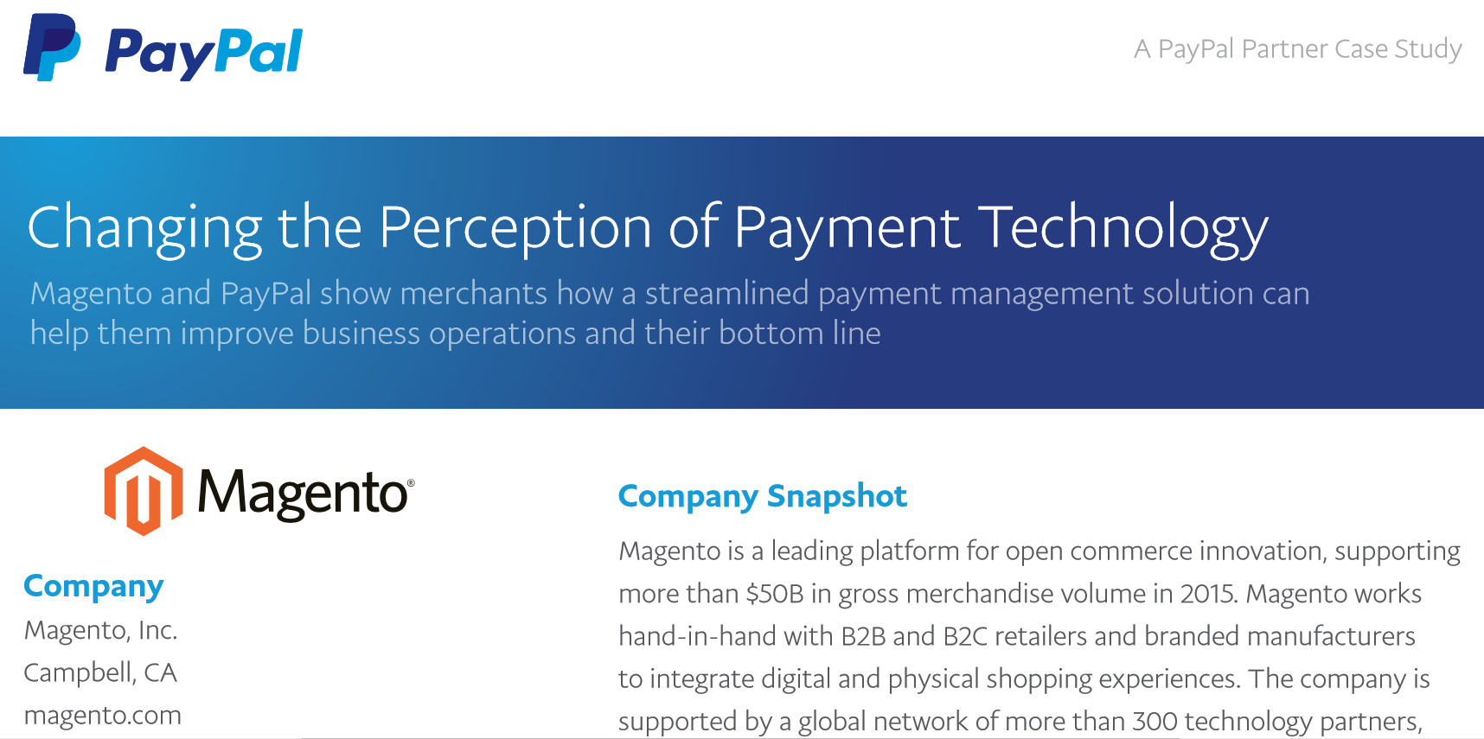
Focusing on Internal Sales Enablement & Education
Team Updates
Info Sheets
Short Form Video
Notes:
Better Access to Merchants, Customer Team, Sales Teams, Internal Magento Teams
New Materials
New meetings and calls

Slide 18
Technology Partner Requests
Call for Content!
Update Your Badges
Renew Your Contracts
Notes:
We’ll email you information regarding your badges the goal is to update them ASAP
VIDEO WE WANT VIDEO

Slide 19
Q & A

Slide 20
Thank you! technologypartnerprogram@magento.com

